Slide 1
Usable Security Design
Network Security
Spring 2020

Slide 2
The Most Powerful Security Tool
The Dental Hygienist asked me what was the best home security for her computer.
Her question was obviously broad
Security against worms/vulnerabilities?
Security against viruses?
Data security?
Anyone wish to guess my answer?

Slide 3
What is a warrior’s Most Powerful Tool?

Slide 4
NO! NO! NO! NO! NO!
This scene convinced me the Jedi were idiots!
It isn’t the Lightsaber that made the Jedi so dangerous
Battles aren’t won during the fighting; they are won in the thinking before hand
Weapons aren’t you most powerful weapon
YOUR MIND IS YOU GREATEST WEAPON (and tool)
My answer to my Dental Hygienist?

Slide 5
EDUCATION

Slide 6
Your Mind is your Most Powerful Tool
“There is no knowledge that is not power” (Ralph Waldo Emerson)
Tools serve to amplify, not replace, mental powers
Some of the most effective attacks simply take advantage of the mentally weak
The Nigerian Email Scam – Yes, people do fall for these
Other attacks take advantage of systems that are too complicated to fully understand
Python language sandboxing

Slide 7
Non-Thinking: A Danger of Technology
“The real question is not whether machines think but whether men do” (B.F. Skinner)
Thousands of years went in to developing our ability to detect physical fraud
Humanity has not had time to evolve with the technology changes
The most common attacks are not really about the technology, but the people
“Only amateurs attack machines; professionals target people” (Bruce Schneier)

Slide 8
Market Realities
Unfortunately, humanity isn’t going to evolve much during your life time
And, equally unfortunately, they aren’t going to get much smarter (as a group)
This is where you come in
The most valuable security professional protects people not systems
You want to learn to create tools that helps idiots be safer
You need to be the strong mind that protects the weak

Slide 9
A clip from Sid Meier’s Alpha Centauri

Slide 10
Social Engineering: Pretexting
Pretexting: phoning someone for info while pretending to be someone else
The goal is to get information that gets you in the system, often a password
Attacks of this sort are often conducted in stages
Attacker starts by getting non-sensitive information
Attacker uses non-sensitive information to convince others of his deception
Your book points out one health institution had 30 such calls a week!

Slide 11
Possible Solutions
Operational Security
Limit who has access (AH HA! PRINCIPLE OF LEAST PRIVILEGE!!!)
Train absolutely everyone that must have access
Periodically test the staff (e.g., by sending them a phishing email)

Slide 12
Social Engineering: Phishing
Phishing: Sending an email that appears to be authentic to get private info
Easy to create an email that looks authentic.
Especially modern emails with HTML and media
The resources are often online, so the phishing email simply points to them
Email is easily forgible
Example attacks:
Tell user they need to change password (and enter old password first)
Tell user they need to update profile including SSN

Slide 13
Spear Phishing
A targeted email to a specific potential victim
Aren’t these names clever?

Slide 14
Possible Solutions
Big problem: the target is your customers
Can’t really limit them, unless you want to go out of business
Can’t really train them
Psychology
Make it hard for them to do the wrong thing
Make it easy to do the right thing
(Obviously easier said than done…)

Slide 15
Limiting Human Error
Errors spring from many sources
Human automation (drive to the wrong place because its common)
Following the wrong rule (information overload)
Not understanding the problem/context

Slide 16
Understanding Human Bias
Humans are not rational
Humans are designed with a bias toward action
If we thought about everything we’d never do anything
We’re programmed to act without thinking
Examples of bias:
We’re more afraid of dying in a plane crash than a car crash

Slide 17
When Emotion Takes Over
When human logic/thinking reaches the end, emotions take over
If we don’t know explicitly what to do, we respond emotionally
So, sometimes education has limited value
The bad guys will always learn how to exploit the part the users don’t know
One solution is safe defaults (AH HA! FAIL SAFE/FAIL SECURE!)
“Our bank will never, ever send email”

Slide 18
Abuses of Authority
Read carefully the book’s examples of how people behave
Under someone else’s authority
When they have authority
Also, people do not like to admit they make mistakes
“Hustlers” take advantage of this
AGAIN, you cannot design assuming the user is dispassionate and rational

Slide 19
Passwords
Three ways of authenticating:
Something you have (token, fob)
Something you are (biometrics)
Something you know (password)
Passwords are the most common because it is the cheapest solution

Slide 20
Password Psychology: Strength?
It’s a good idea to require long complicated passwords, right?
Unless the user writes it down (easily compromised)
Or has to keep resetting it (easily compromised)
It’s a good idea to require the user to change passwords regularly, right?
See the problems above
KEY POINT:
If you make security hard, the user will opt out

Slide 21
Password Security Usability
Protecting the entry form-factor
Bad example: PINs at ATMs
Protecting the password transmission
Passwords sent in the clear are bad. Encrypt or hash!
Challenge/Response is a good solution. Simple example:
Both sides know password
Server sends Nonce
Client sends back secure hash of password+Nonce

Slide 22
Password Guessing Issues
Common solution is to freeze account or entry after multiple bad attempts
This can open up denial of service attacks
Can’t use this, for example, in the military
Better solution is to require good passwords that cannot be guessed
However, watch out for “side channel” attacks on password guessing
Passwords checked one character at a time are vulnerable to timing attacks
Some smart cards passwords compromised by energy consumption

Slide 23
Password Storage
DON’T STORE THE PASSWORD IN CLEAR TEXT!!!
No really, I’m serious, don’t.
I’m wagering that one of you will make this mistake this semester in PLAYGROUND
Better solution: Store the hash of the password (with a salt)
You can use this in place of a challenge response
This way, the server NEVER knows the password

Slide 24
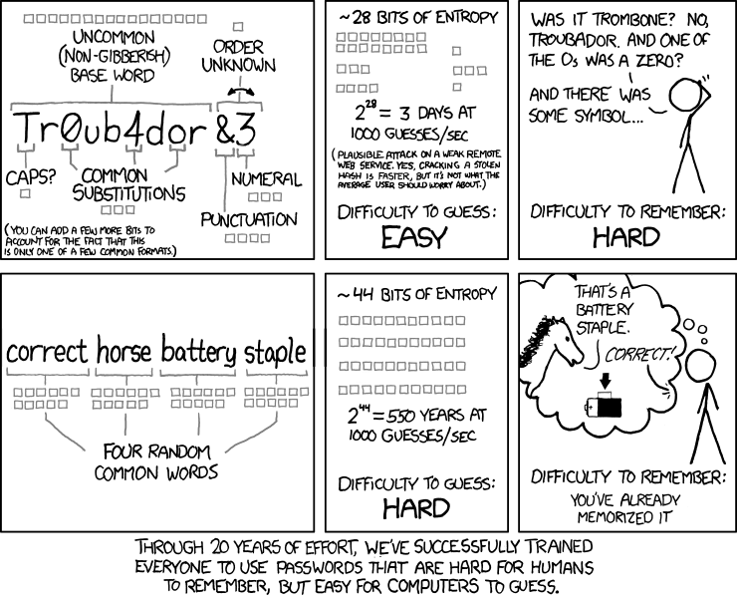
A Word about choosing Passwords
My favorite method is to choose 4 random words
XKCD #936:

Slide 25
Password Entropy
You should understand this
However, password entropy is beyond the scope of this class
You might want to look it up on your own
No really, you should

Slide 26
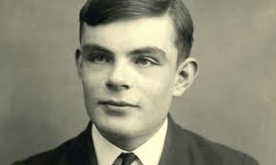
CAPTCHAs
Good case study!
Combine psychology, usability, and system design nicely
Designed around what humans do well that computers do not
“Completely Automated Public Turing Test to Tell Computers and Humans Apart”
Thanks Alan Turing!

